Slide 1
QA Evaluation Form
Chat Quality Monitoring Guidelines

Slide 2
CALL / CHAT HANDLING WORKFLOW
Step 1
Open and brand interaction.
Verify the account using appropriate verification procedures.
Empathizing with the customer reason for the interaction.
Step 4
Offer further assistance.
Close interaction with the proper script, branding the call / chat.
OUTRO
SATISFIED
CUSTOMER
INTRO
RESOLUTION
Step 3
Follow proper steps to resolve the customer’s issue.
Thoroughly document the interaction.
Escalate to the proper department if needed.
Educate of self-care options.
Step 2
Ask appropriate questions to determine what is the root cause of the problem.
PROBING
Notes:
© Copyright PresentationGO.com – The free PowerPoint and Google Slides template library

Slide 3
Quality ScoreCard
CATEGORY | VALUE
Welcome and Customer Engagement | 22 points
Build a Connection | 18 points
Solution Building | 27 points
Altice Procedures | 33 points
Autofails | All points

Slide 4
Welcome and Customer Engagement
1) Begin the conversation with the proper greeting and script. Use the customer's name throughout the interaction.
Thank you for contacting Altice, my name is … and I will be more than happy to assist you today! Please allow me 1-2 minutes while I review your previous interaction.
Thank you for contacting Altice. How can I help you?

Slide 5
2) Display willingness to assist the customer.
Use a transitional statement to assure the customer you understand their needs and you will be happy to help.
Ok. I will open your bill.
I’ll be happy to assist you creating your ID!

Slide 6
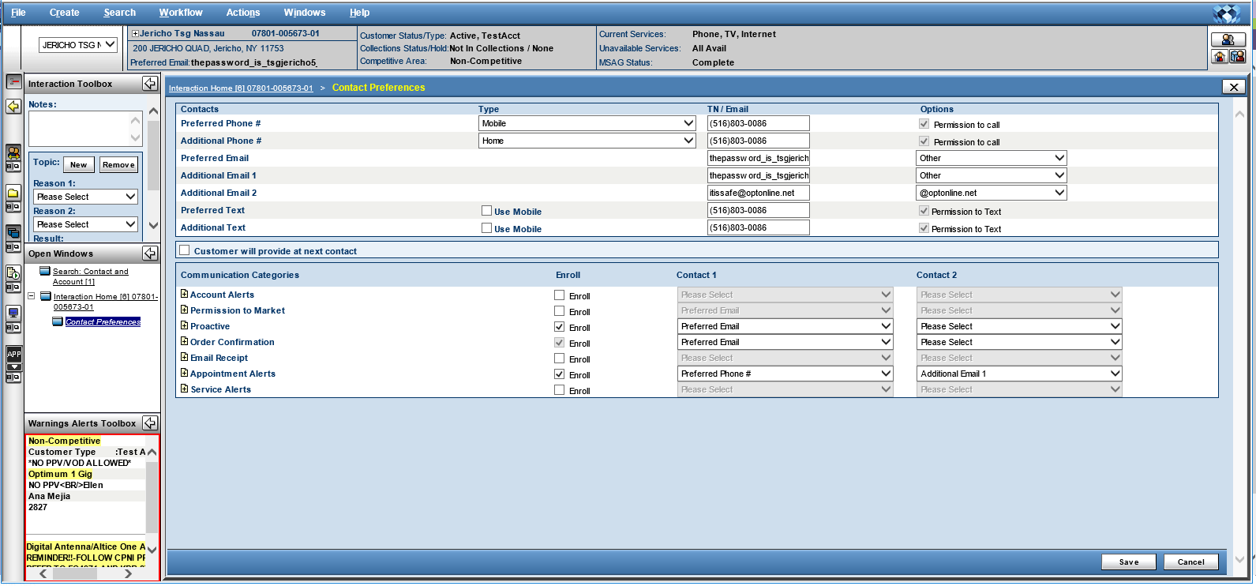
3) Update Contact Preference (CPC)
The agent must update the contact preference (CPC) when an account to avoid missed appointment in the future. “Include Phone number and Email Address”.

Slide 7
4) Protect the customer’s privacy and personal information by following the verification procedure.
Complete the customer verification process correctly according to Altice policies and procedures.

Slide 8
Build a Connection
5) Utilize the appropriate holding time script and respond in the correct time frame.
Agent must keep the interaction active with the customer, not exceeding the time frame specified to respond of two minutes and sending appropriate holding and interactive scripts.
Response time: 2 minutes or less.
Thank you so much for your patience. I am still reviewing your bill. Please allow me 3-5 minutes more.
Thank you for your time, I still running the tests. I will be back in 3-5 minutes.
Please stay with me, I am searching the information on your account.

Slide 9
6) Convey a friendly demeanor throughout the interaction with empathy statements.
I’m sorry that your internet is not working properly. I’ll do my best to fix it.
Congrats for your newborn!
Merry Christmas!!
7) Proper use of punctuation, avoiding typographical errors and never using internal language with the customer.
Effectively use punctuation and capitalization rules when appropriate. Properly communicate information to the customer by virtue of correct spelling and appropriate sentence structure.

Slide 10
Solution Building
8) Ask discovery and probing questions to provide a response or solutions to the customer’s inquiry.
Is this issue happening on all your devices?
When did you make the payment?
Is there any lights on the modem?
9) Use all available tools and resources to arrive at a personalized solution for the customer.
MT IBA ITT BOOST KDB Suddenlink Website

Slide 11
10) Address all questions and concerns, provide the proper resolution and information.
Properly address all questions that the customer brings up and provide best possible solution. E.g.
- If the customer have a billing inquiry, wants to reset an ID password and is missing channels from the TV service, you need to bring a solution for all of them.
11) Provide assurance statements, promoting the value of the service.
Properly assurance statements promoting the value of the service in order to avoid the customer to disconnect the account or services.

Slide 12
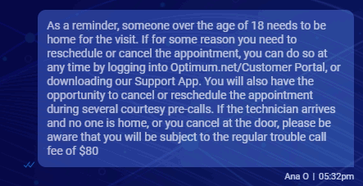
Altice Procedures
12) Inform about TC policies, appointment discipline, and recommendations of service protection.

Slide 13
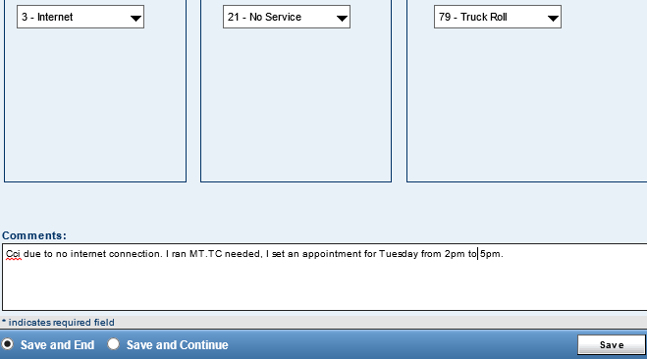
13) Leave thorough notations that document resolution and expectations set with the customer.
Thoroughly capture notes for the entire interaction and ensure all notes are easily understood, specifying the reason and resolution of the interaction. You should leave notes on Remedy and IDA.
14) Follow all applicable procedures with the customer.
Ensuring all proper steps are strictly followed, including all troubleshooting steps and guidelines.

Slide 14
15) Educate the customer on all self-service options including mobile apps, IVR options, or web portals.
Customer should be encouraged to utilize all self-help options on the website, Suddenlink Apps, etc., to avoid the chance of a customer chatting back.
Please keep in mind that you can set security question on the website so you can reset the password.
As a reminder, you can review your bills and make payments online.
16) Use chat appropriate recap of the conversation and use proper closing script.
Explain briefly the sum-up of the conversation, detailing the reason of the chat and the resolution. Use an appropriate closing.
E.g. As a recap, you contacted us to add HBO on demand and create an ID. We added the channel and crate laura123. Thank you so much for contacting Altice, it has been a pleasure to assist you today. If you have any further questions do not hesitate in contacting us back. Have a wonderful rest of your day!

Slide 15
AUTOFAILS

Slide 16
Business critical
17) CPNI Breach and provide information from the customer’s account.
Disclose private information of the account as account holder’s name, address, phone or ID and make modifications as add channels, activate new modem, change WIFI password or create IDs without completing the security process.
Always ask for: - CMAC of the modem - ECM MAC or CA S/N of Altice One box - Serial number or MAC of Cable box - Access Code

Slide 17
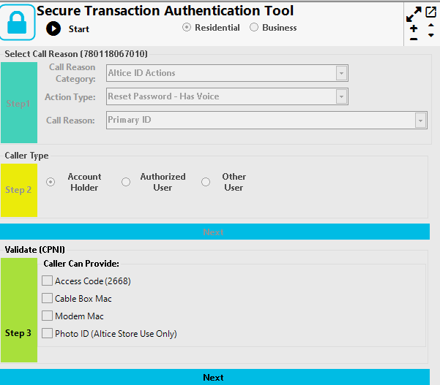
CPNI Methods
When CPNI is needed to perform the action requested by the customer, you can only use one of these three methods:
Cable Box Mac
Modem Mac
Access Code

Slide 18
18) Provided misleading information to the customer.
Incorrect information was provided to the customer, setting the wrong expectations.
E.g.
You will receive a credit of $80 for the appointment fee.
I will add a promotion on your account saving you $50.00
19) Arguing with the customer.
Disrespect the customer and answering in a rudely manner. Being condescending, sarcastic, etc.
I don’t care that your internet doesn’t work.
I can’t provide you with the credit because you never pay on time, that’s not my problem.

Slide 19
20) No attempt to resolve.
Not following all proper steps with the customer and avoiding, providing the wrong resolution.
I’m not billing department please call to review your bill.
I can’t troubleshoot your modem. Contact us later.
21) Closing conversations on customers when not applicable.
Ending the interaction abruptly where the customer concern is not yet addressed or having an invalid transfer by sending the interaction back to the queue.

Slide 20
Metric | Goal
OSAT | 8.5 → 9.5+
NPS | 2.4 → 3.0+
PCC (% Closed Conversations) | 55.00% +
First Response | 2:00 Minutes
Response Time | 2:00 Minutes
Notes:
© Copyright PresentationGO.com – The free PowerPoint and Google Slides template library

Slide 21
Bonus Structure
OPS
Los agentes pueden ganar desde RD $ 160 hasta RD $ 230.00 por hora.
6
9.5+
7
9-9.4
8-8.9
Keep Trying
+15.50 pesos
x hora
Work Harder
+11.36 pesos
x hora
+8.79 pesos x hora
Notes:
© Copyright PresentationGO.com – The free PowerPoint and Google Slides template library

Slide 22
Bonus Structure
NPS
Los agentes pueden ganar desde RD $ 160 hasta RD $ 230.00 por hora.
0-1
3.0+
1-1.9
2.5-2.9
2-2.4
Keep Trying
+15.50 pesos
x hora
Work Harder
+11.36 pesos
x hora
+8.79 pesos x hora
Notes:
© Copyright PresentationGO.com – The free PowerPoint and Google Slides template library

Slide 23
More money….
First response +13 pesos por hora
Response Time +13 pesos por hora
Close Rate +13 pesos por hora
Condiciones de Recompensa y Plan de Reconocimiento:
• Si el porcentaje de conversaciones cerradas apropiadamente está por debajo de 45% no se pagarán ninguno de los bonos.
• Si el OSAT está por debajo de 7.0, no se le paga el bono de primera respuesta ni de tiempo de respuesta.
• Si el tiempo de primera respuesta está por encima de 3.00 minutos no se le pagará el bono de satisfacción en general ni de puntaje neto de promotor.
Notes:
© Copyright PresentationGO.com – The free PowerPoint and Google Slides template library

